Slide 1
Section 10: BEHIND THE SUPPLY CURVE: PROFIT, PRODUCTION, AND COSTS
Module 52: Defining Profit

Slide 2
Key Economic Concepts For This Module:
• Profit is defined as total revenue dollars earned minus total costs incurred.
• While accountants and economists agree about how to define total revenue, price multiplied by units sold, they differ on the definition of total costs.
• At the most basic levels, accountants recognize only the explicit costs of production. These are the direct monetary outlays for things like wages, raw materials and interest payments on borrowing.
• Economists also recognize the explicit production costs, but also include the implicit costs of production. Implicit costs of production are the opportunity costs of using the firm’s resources in the next best alternative use
• If only the explicit costs are subtracted from total revenue, the result is defined as accounting profit.
• If, after subtracting both explicit and implicit costs of running a business, the firm is earning zero economic profit, it is also earning what economists define as a normal profit.

Slide 3
Order of Presentation
I. Understanding Profit
A. Explicit versus Implicit Costs
B. Accounting versus Economic Profit
C. Normal Profit

Slide 4
Silver Trading Activity
Instructions online:
Duffka.com>C219>Activities>Silver Trading Activity.
Questions:
Submit for credit after the activity.

Slide 5
I. Understanding Profit
Firms are assumed to produce the level of output that maximizes profit. Profit is equal to total revenue minus total cost.
Note: it is common in economics textbooks to identify profit with the Greek symbol pi (π).
π = Total Revenue – Total Cost
Accountants and economists both define total revenue as equal to the quantity of units sold multiplied by the price at which they were told. In other words:
TR = P*Q
The more difficult component of profit is the precise definition of total cost.

Slide 6
I. Understanding Profit
A. Explicit versus Implicit costs
All costs are opportunity costs. They can be divided into explicit costs and implicit costs.
An explicit cost is a cost that involves actually laying out money. Examples include: Rent for office space, wages to employees, interest on debt, raw materials, depreciation on equipment, and utility bills.
These are referred to as “accounting costs.”
Think of an EXPLICIT COST as a payment that must be made:

Slide 7
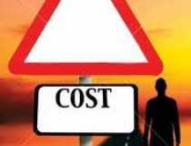
I. Understanding Profit
A. Explicit versus Implicit costs
All costs are opportunity costs. They can be divided into explicit costs and implicit costs.
An explicit cost is a cost that involves actually laying out money. Examples include: Rent for office space, wages to employees, interest on debt, raw materials, depreciation on equipment, and utility bills.
These are referred to as “accounting costs.”
An implicit cost does not require an outlay of money; it is measured by the value, in dollar terms, of the benefits that are forgone. Examples include: forgone salary, interest income given up, a building or other capital that could be rented but is self-employed.
These are referred to as “economic costs.”
An implicit cost is an opportunity cost.

Slide 8
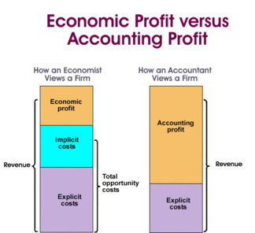
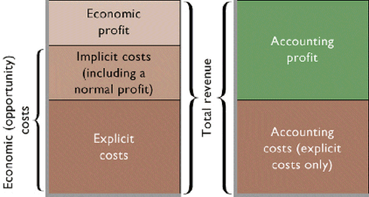
I. Understanding Profit
Economic profit is more difficult to achieve because of the opportunity cost of the current decision:

Slide 9
I. Understanding Profit
A. Explicit versus Implicit costs
Businesses can face implicit costs for two reasons.
1. A business’s capital could have been put to use in some other way. Capital in a business is the value of its assets—equipment, buildings, tools, inventory, and financial assets.
The implicit cost of that capital is the opportunity cost of the capital used by a business—the income the owner could have realized from that capital if it had been used in its next best alternative way.
A local example would be the owners of Randhurst mall changing the location to a mix of commercial and residential to MAXIMIZE the land’s value. The implicit cost to leave it in the old format was too high.

Slide 10
I. Understanding Profit
A. Explicit versus Implicit costs
1. A business’s capital could have been put to use in some other way.
2. The owner devotes time and energy to the business that could have been used elsewhere.
Considering the cost of an activity, you should include the cost of using any of your own resources for that activity. The most personal of these resources is the value of the entrepreneur’s labor in the next best occupation.
Net Worth=$5 billion

Slide 11
Richard Branson-Entrepreneur

Slide 12
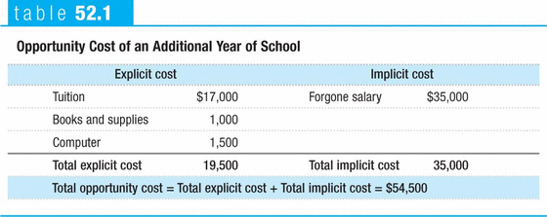
I. Understanding Profit
A. Explicit versus Implicit costs
1. A business’s capital could have been put to use in some other way.
2. The owner devotes time and energy to the business that could have been used elsewhere.

Slide 13
I. Understanding Profit
A. Explicit versus Implicit costs
B. Accounting Profit vs. Economic Profit
Companies report their accounting profit, which is not necessarily equal to their economic profit.
Accounting profit of a business is the business’s revenue minus the explicit costs and depreciation.
Profit = Total Revenue – Total Explicit Costs
Economic profit of a business is its revenue minus the opportunity costs of its resources; both explicit and implicit. It is usually less than the accounting profit.
Economic Profit = Total Revenue – Total Explicit Costs – Total Implicit Costs

Slide 14
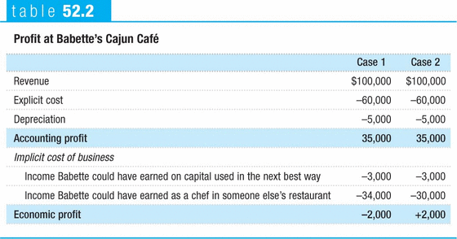
I. Understanding Profit
A. Explicit versus Implicit costs
B. Accounting Profit vs. Economic Profit

Slide 15
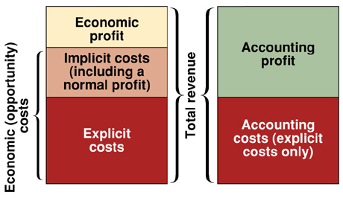
I. Understanding Profit
A. Explicit versus Implicit costs
B. Accounting Profit vs. Economic Profit
C. Normal Profit
When economic profit is equal to zero, or break-even, the firm is said to be earning a “normal profit”.
If you can earn enough total revenue to cover every cost, both out of pocket and the choices you gave up, a normal profit is enough to keep you from changing jobs.

Slide 16
Jobs Czar-60 Minutes

Slide 17
SUBMIT THE MOD 52 QUIZ ANSWERS ONLINE
PRACTICE QUESTION #1
1. Which of the following is an example of an implicit cost of going out for lunch?
a. the amount of the tip you leave the waiter
b. the total bill you charge to your credit card
c. the cost of gas to drive to the restaurant
d. the value of the time you spent eating lunch
e. all of the above

Slide 18
PRACTICE QUESTION #2
2. Which of the following is an implicit cost of attending college?
a. tuition
b. books
c. laptop computer
d. lab fees
e. forgone salary

Slide 19
PRACTICE QUESTION #3
3. Which of the following is the best definition of accounting profit? Accounting profit equals total revenue minus depreciation and total
a. explicit cost only.
b. implicit cost only.
c. explicit cost plus implicit cost.
d. opportunity cost.
e. explicit cost plus opportunity cost.

Slide 20
PRACTICE QUESTION #4
4. Which of the following is considered when calculating economic profit but not accounting profit?
a. implicit cost
b. explicit cost
c. total revenue
d. marginal cost
e. All of the above are considered when calculating accounting profit.

Slide 21
PRACTICE QUESTION #5
5. You sell T-shirts at your school’s football games. Each shirt costs $5 to make and sells for $10. Each game lasts two hours and you sell 100 shirts per games. You could always be earning $8 per hour at your other job. Which of the following is correct? Your accounting profit from selling shirts at a game is
a. $1,000 and your economic profit is $500.
b. $500 and your economic profit is $1,000.
c. $500 and your economic profit is $484.
d. $484 and your economic profit is $500.
e. $500 and your economic profit is also $500.

