Slide 1
AP Friday – Do Now
Go back to your packet and complete Activity 1-2, Part C only.

Slide 2
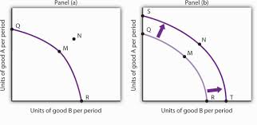
Economic Growth and Production Possibilities
Economic growth results from;
Increased productivity
Increased education
Advances in technology
If the PPC shifts to the
right, the economy is experiencing growth
Finish up 1-2 right now!

Slide 3
Module 4: Specialization and Gains from Trade
Why I have a cleaning service.
It takes me 5 hours to clean the house
My professional time is worth $28/hour (sad but true)
My opportunity cost for cleaning is $140
The service charges $85
Absolute Advantage- refers to a party’s ability to produce a certain good more efficiently than another country.
Comparative Advantage- refers to a country’s ability to produce a particular good with a lower opportunity cost than another country.

Slide 4
Module 4: Absolute and Comparative Advantage
Between two parties, one will have lower opportunity cost to produce – so both parties will gain if they each produce the good/service for which they have a lower opp. cost.
Both parties will gain if they each specialize and then trade

Slide 5
Module 4: Absolute and Comparative Advantage
If they produce only pizzas, then in a single day Alana can produce 20 pies while Andrew can produce 10 pies. If they only make lemonade, then in a single day Alana can produce 10 lemonades while Andrew can produce 4 lemonades. We then know that:
 | Pizzas Pies | Lemonades
Alana | 20 | 10
Andrew | 10 | 4

Slide 6
Concepts in Practice: Absolute and Comparative Advantage
So who should make the pizzas?
Alana has the absolute advantage for both pizza and lemonade making, but both parties will be better off if they specialize and trade.
Use the output method to decide who has the lower opportunity cost

Slide 7
Concepts in Practice: Absolute and Comparative Advantage
Output Method
Column A (B/A) Column B (A/B)
10/20
20/10
4/10
10/4
Lower opportunity cost
In Part B of 1-3, problems 1, 2, and 5 are output problems, do those now.

Slide 8
Refresh for Reading Quiz
Tips and Tricks

Slide 9
Terms and Concepts
Know your definitions:
Economics
Scarcity
Microeconomics
Macroeconomics
Normative
Positive
Opportunity Cost
Resources
Land, Labor, Physical, Human
Marginal Benefit
Marginal Cost
Marginal Analysis
Recession
Business cycle
Inflation
Incentives
Specialization and Trade
Comparative Advantage
Barter
Tariff

Slide 10
Concepts in Context: Opportunity Cost
If I can buy a slice of pizza or a cold drink with my $2.00, and I choose the cold drink, my opportunity cost for the drink is:
A) $2.00
B) The slice of pizza

Slide 11
Concepts in Practice: Production Possibilities
Alternatives | A | B | C | D | E | F
Fish | 0 | 1 | 2 | 3 | 4 | 5
Coconuts | 30 | 28 | 24 | 18 | 10 | 0
Table 3-1: Production Possibilities Schedule I
Be able to read these tables for different scenarios.
The alternatives are exactly that.
If you choose to catch 3 fish you have the resources to gather 18 coconuts.
Opportunity cost can be calculated from the table:
If I choose to catch one more fish, I give up 8 coconuts.

Slide 12
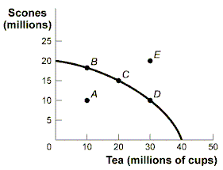
Concepts in Practice: Production Possibilities
Be able to interpret the model
Clue: If the point is inside the curve (A), resources are not being used efficiently
Outside the curve is not feasible
If the curve moves to the right, we are experiencing ECONOMIC GROWTH

Slide 13
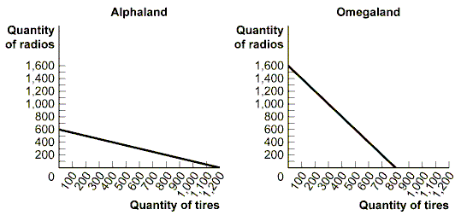
Practice: Comparative Advantage
1. Alphaland and Omegaland) The opportunity cost of producing 1 tire in Alphaland is ________ radio(s), while the opportunity cost of producing 1 tire in Omegaland is ________ radio(s).
a. 1/2; 2
b. 2; 1
c. 600; 800
d. 800; 1,200
e. 2; 1/2

Slide 14
Practice: Comparative Advantage
2. Alphaland and Omegaland) Alphaland has a comparative advantage in producing ________, while Omegaland has a comparative advantage in producing ________.
a. both radios and tires; neither good
b. neither good; both radios and tires
c. radios; tires
d. tires; radios
e. tires; neither good

