Slide 1
The Perfectly Competitive Firm
In 15 minutes!

Slide 2
Characteristics
1. Many buyers and many sellers.
2. The goods offered for sale are largely the same.
3. Firms can freely enter or exit the market.
Each Firm is a “price-taker”.

Slide 3
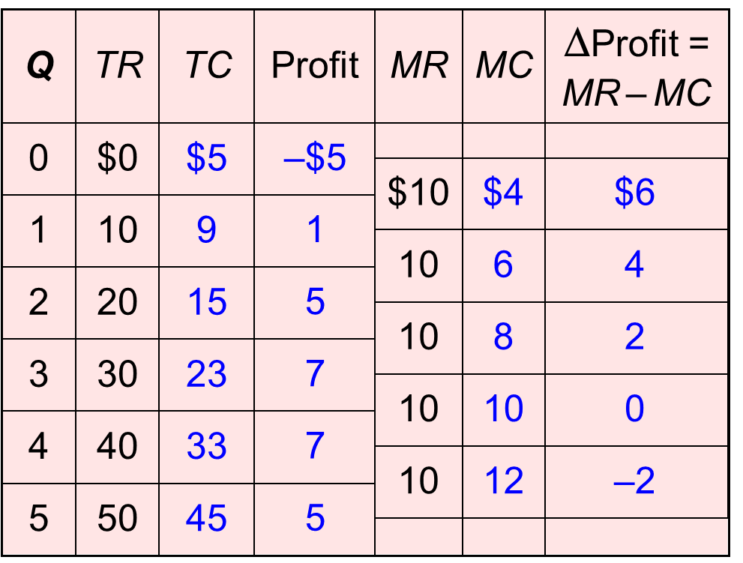
Table of Revenues & Costs
Price =$10
Marginal Revenue = $10
Find where Marginal cost = $10
Profit is max

Slide 4
MC and the Firm’s Supply Decision
0
Rule: MR = MC at the profit-maximizing Q.
At Q_{a}, MC < MR.
So, increase Q to raise profit.
At Q_{b}, MC > MR.
So, reduce Q to raise profit.
At Q₁, MC = MR.
Changing Q would lower profit.
Costs
MC
P₁
MR
Q
Q_{a}
Q₁
Q_{b}
Notes:
4
This slide is similar to Figure 1 in the chapter. I’ve omitted the AVC and ATC curves (which appear in Figure 1 in the chapter) because they are not needed at this point.

Slide 5
Costs in more detail
Q | TR | MR | TC | FC | VC | MC | AFC | AVC | ATC
0 | 0 | - | 5 | 5 | 0 | - | - | - | -
1 | 5 | 5 | 7 | 5 | 2 | 2 | 5 | 2 | 7
2 | 10 | 5 | 9 | 5 | 3 | 2 | 2.5 | 1.5 | 4.5
3 | 15 | 5 | 12 | 5 | 7 | 3 | 1.67 | 2.33 | 4
4 | 20 | 5 | 16 | 5 | 11 | 4 | 1.25 | 2.75 | 4
5 | 25 | 5 | 22 | 5 | 17 | 6 | 1 | 3.4 | 4.5
Fortunately these tables aren’t on this quiz!

Slide 6
The short-run picture
A competitive firm
Costs, P
Profit-maximizing position is where MC=MR
In this scenario there is positive economic profit
($10 - $6) x 50
MC
P = $10
MR
ATC
AVC
$6
Q
50

Slide 7
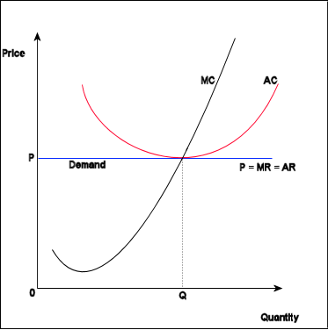
The long-run picture

